Slide 1


REACT ES6 - Arrow Functions
React is much easier to learn if you know ES6.

Slide 2
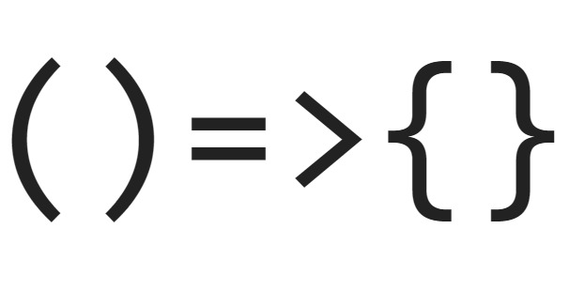
Arrow Functions
Arrow Functions — also called “fat arrow” functions.
Arrow functions allow us to write shorter function syntax:
Before:
hello = function() {
return "Hello World!";
}
After:
hello = () => {
return "Hello World!";
}

Slide 3

Arrow function in context of This
The handling of this is also different in arrow functions compared to regular functions. In regular functions this keyword represented the object that called the function, which could be the window, the document, a button etc.
With arrow functions, this keyword always represents the object that defined the arrow function.

